Slide 1
Seed Transfer 2.0:
Establishing plantations for the new normal
Federation of BC Woodlot Associations
Greg O’Neill
Tree Improvement Branch
FLNRO
Oct. 2015
Notes:
Dire news
Reason for optimism > FP proactive and exercise leadership in CC battle.

Slide 2
Seed Transfer 2.0
Assisted migration – why? (9 slides)
Assisted migration – how? (6 slides)
Diversification - why and how? (4 slides)

Slide 3
Glimpse
BB, CH and pest resistance genetically programmed to climate of grandparents > Impacts
Exaggerated< 32 years in elevated temp
Reforestation paradigm “local is best” > decr. ecological goods and services

Slide 4
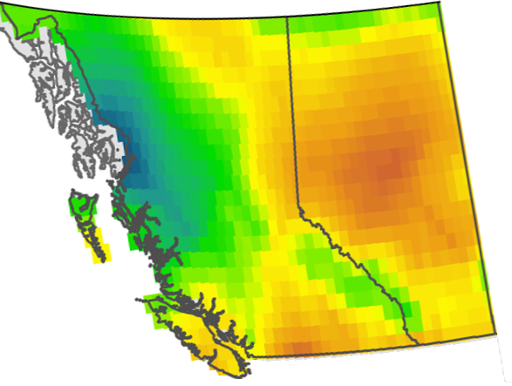
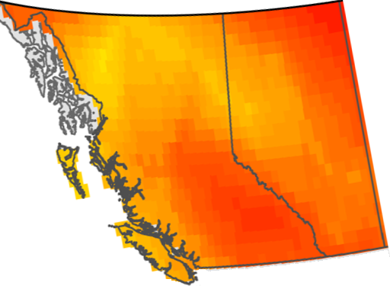
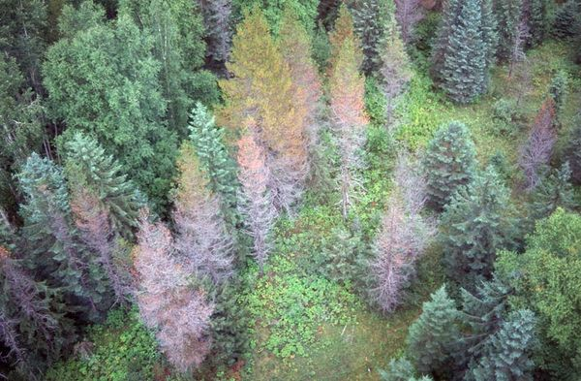
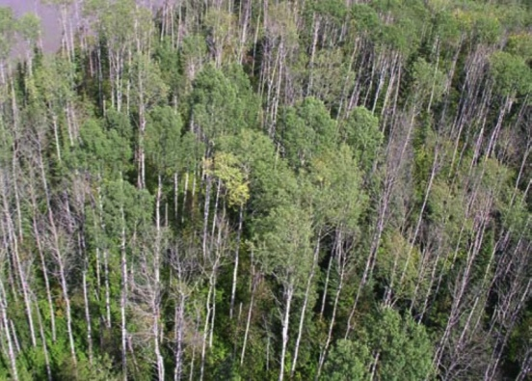
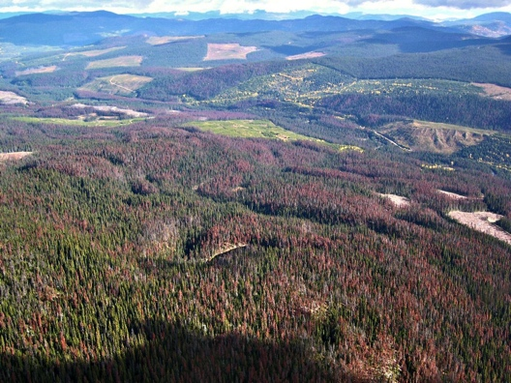
Risks associated with inaction
Observed climate trends & impacts
25-year trend in precipitation
25-year trend in winter temperature
Dothistroma needle cast
Spruce & aspen dieback
Mountain pine beetle
Woods et al. 2006
Hogg et al. 2008
Michaelian et al. 2010
Allen et al. 2010
Image: Sally Aitken/Andreas Hamann
Notes:
MPB in BC – 700 million m3 timber
Linked to change in winter temp
Mortality < Yc in Alaska
Mortality < pinyon forests of California & SW states

Slide 5
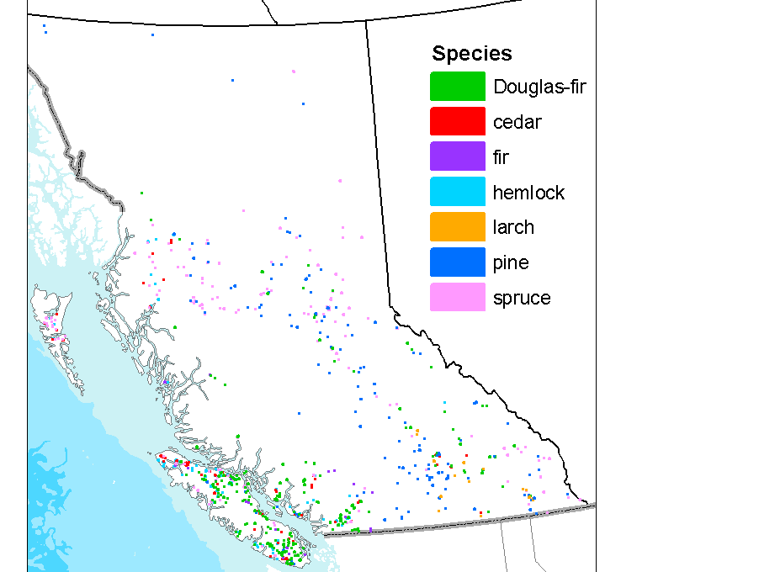

Slide 6
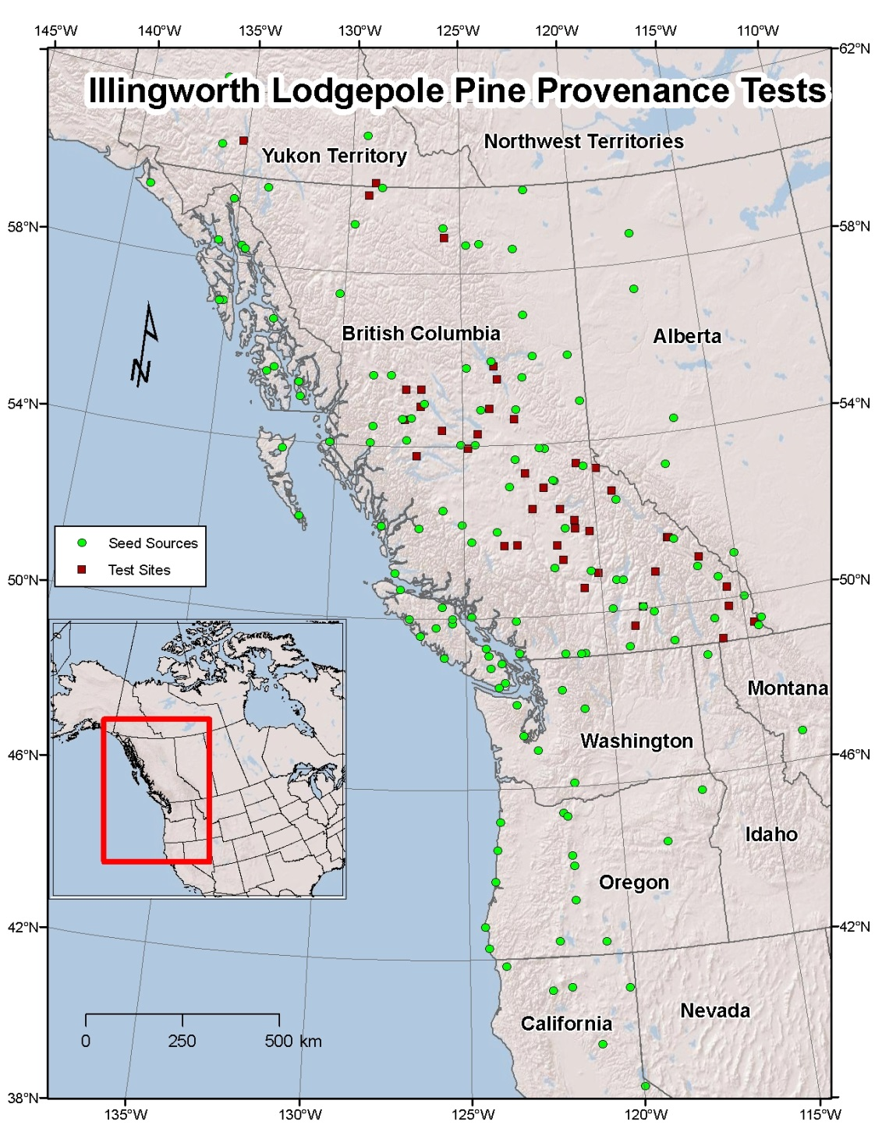

Slide 7
plant
harvest
22%
-30%
Notes:
Little cost.
Warm seed good. Cold seed bad.
Hx – pops tracked climate by evol’n (mig’d & nat sel)
rate of climate mig’n >> pop mig’n
Best defence against CC – exploit evol’n – plant adapted pop’n
Fit

Slide 9
Test site: Fort St. John
Test site: Fort St. John
Species: coastal yellow-cedar
Species: western larch

Slide 10
Seed Transfer 2.0
Assisted migration – why? (9 slides)
Assisted migration – how? (6 slides)
Diversification - why and how? (4 slides)

Slide 11
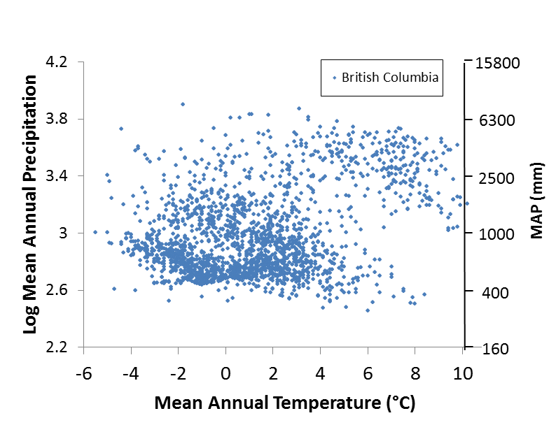
Cutblock
Seed procurement zone
CSTD
Notes:
Shift
2000 random points
Wet warm coast
Cutblock @ 0°C and 700 mm MAP
Dots = candidate seed sources
Oval = procurement zone
CSTD varies w site and sp
Old School - 2007

Slide 12
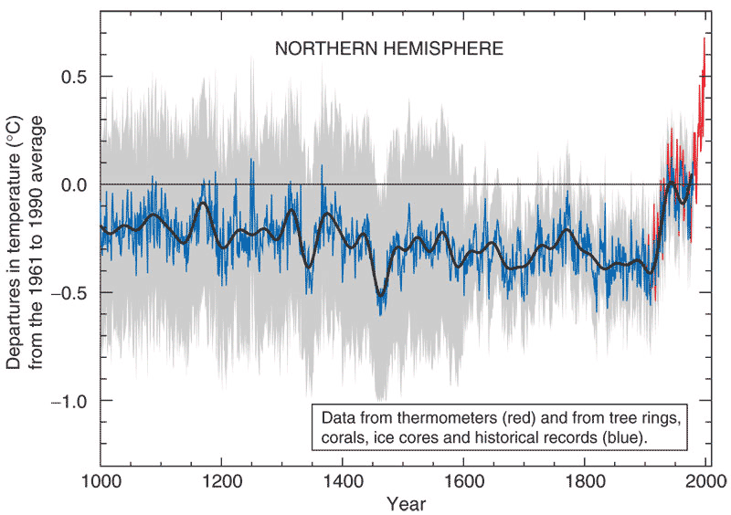
Evolutionary lag
IPCC 2001

Slide 13
Cutblock
Seed procurement zone
Mig. dist.
Notes:
Considering recent CC > best SS not local…
Migration vector w 2 components
Also consider future change…

Slide 14
Summary – assisted migration
Warm seed good. Cold seed bad.

Slide 15
Seed Transfer 2.0
Assisted migration – why? (9 slides)
Assisted migration – how? (6 slides)
Diversification - why and how? (4 slides)

Slide 16
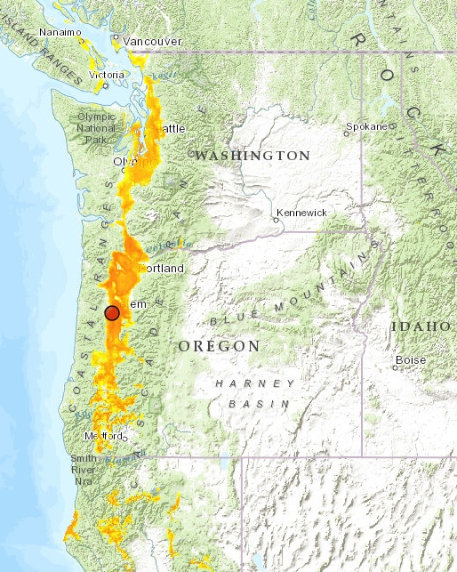
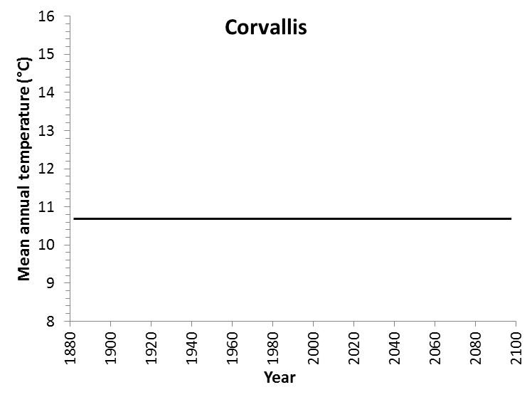
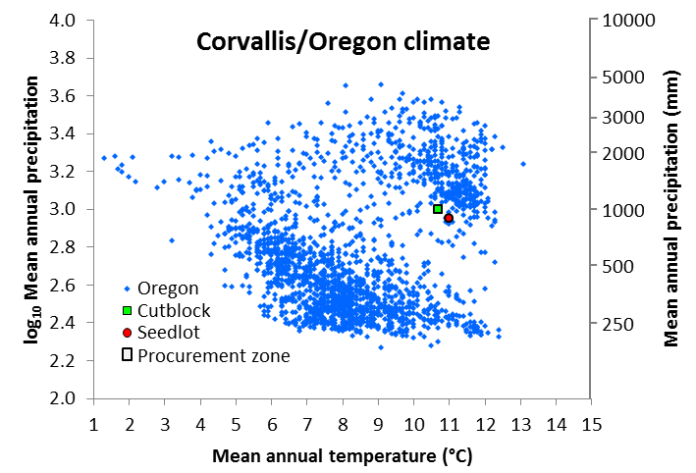
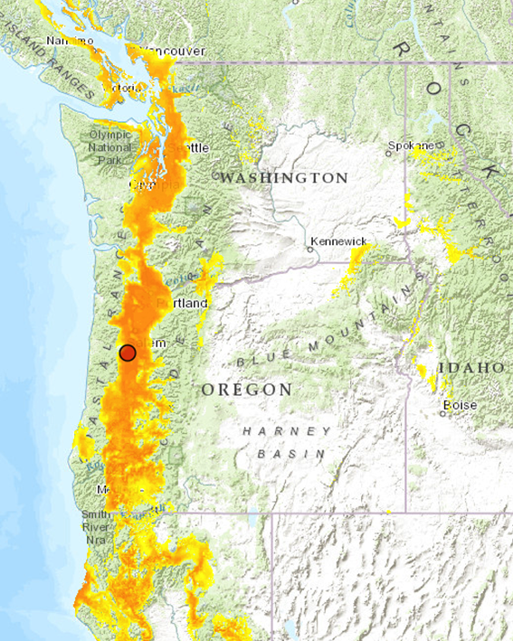
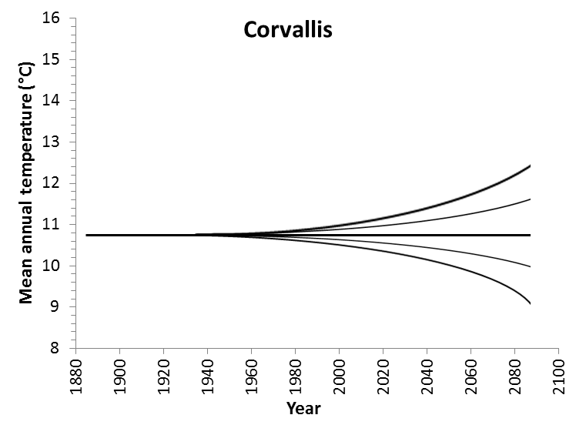
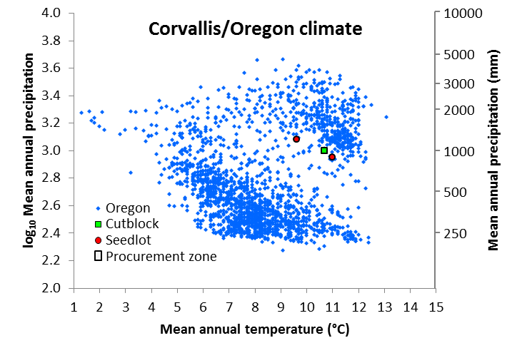
Uncertainty: none
CC: no
Uncertainty addressed by:
- enlarging the procurement space
- using multiple seed sources
Uncertainty: moderate
CC: no
Notes:
Past paradigm
Climate constant > pops locally adapted = no lag
Target seed source climate = cut block climate
Procurement space = f(uncertainty at rotation)

Slide 17
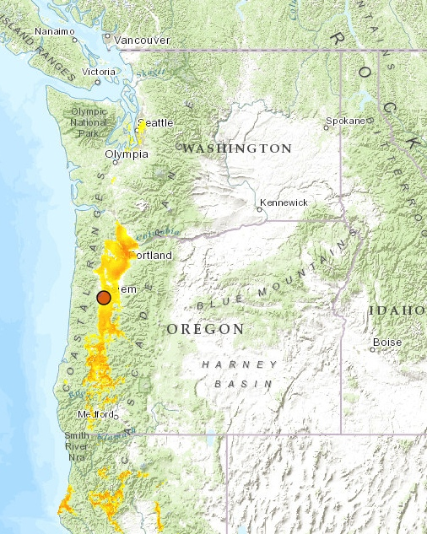
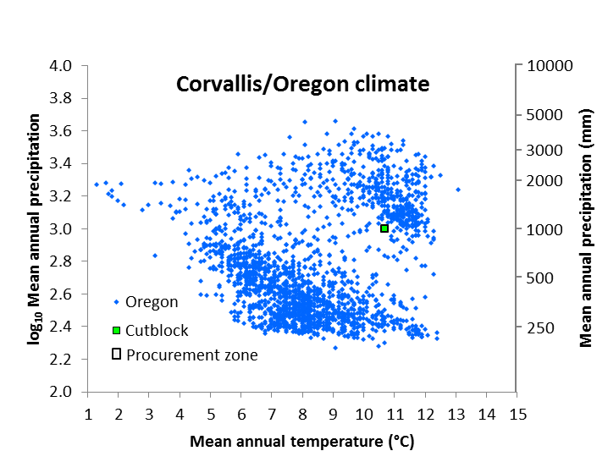
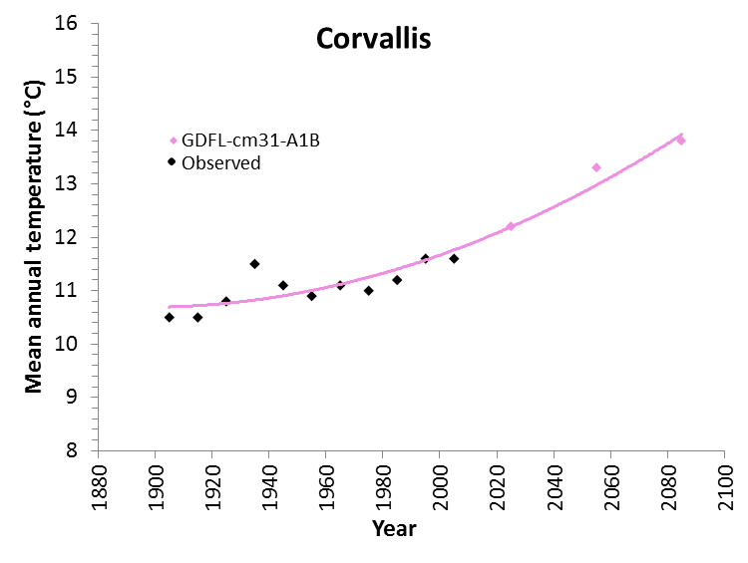
Uncertainty: none
CC: yes
Seedlot

Slide 18
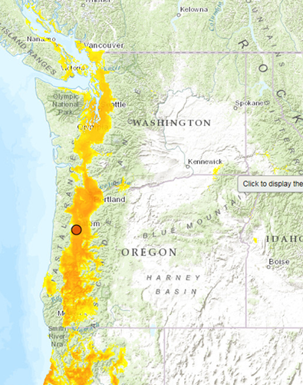
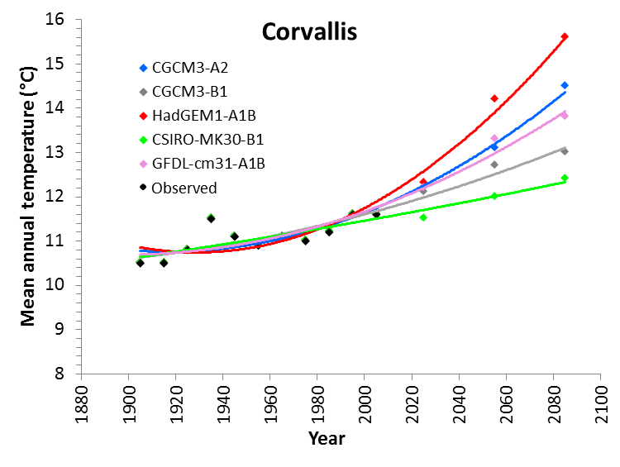
Uncertainty: none
CC: yes
Seedlot
Uncertainty addressed by enlarging the procurement space and using multiple seed sources
Climate change addressed by migrating the target climate
Uncertainty: mod.
CC: yes
Notes:
Migr Dist = change calculated from avg of several GCMs at ¼ rotation.

Slide 19
Summary - diversification
Enlarge and multiply.

Slide 20
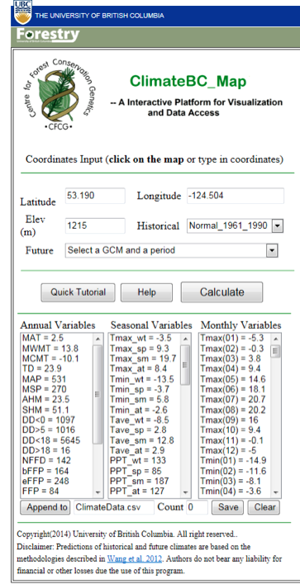

Slide 21
Acknowledgements:
CBST science working group:
Lee Charleson
Leslie McAuley
Nick Ukrainetz
Tongli Wang
Alvin Yanchuk
Susan Zedel
ForSite Consultants Ltd.

